Slide 1

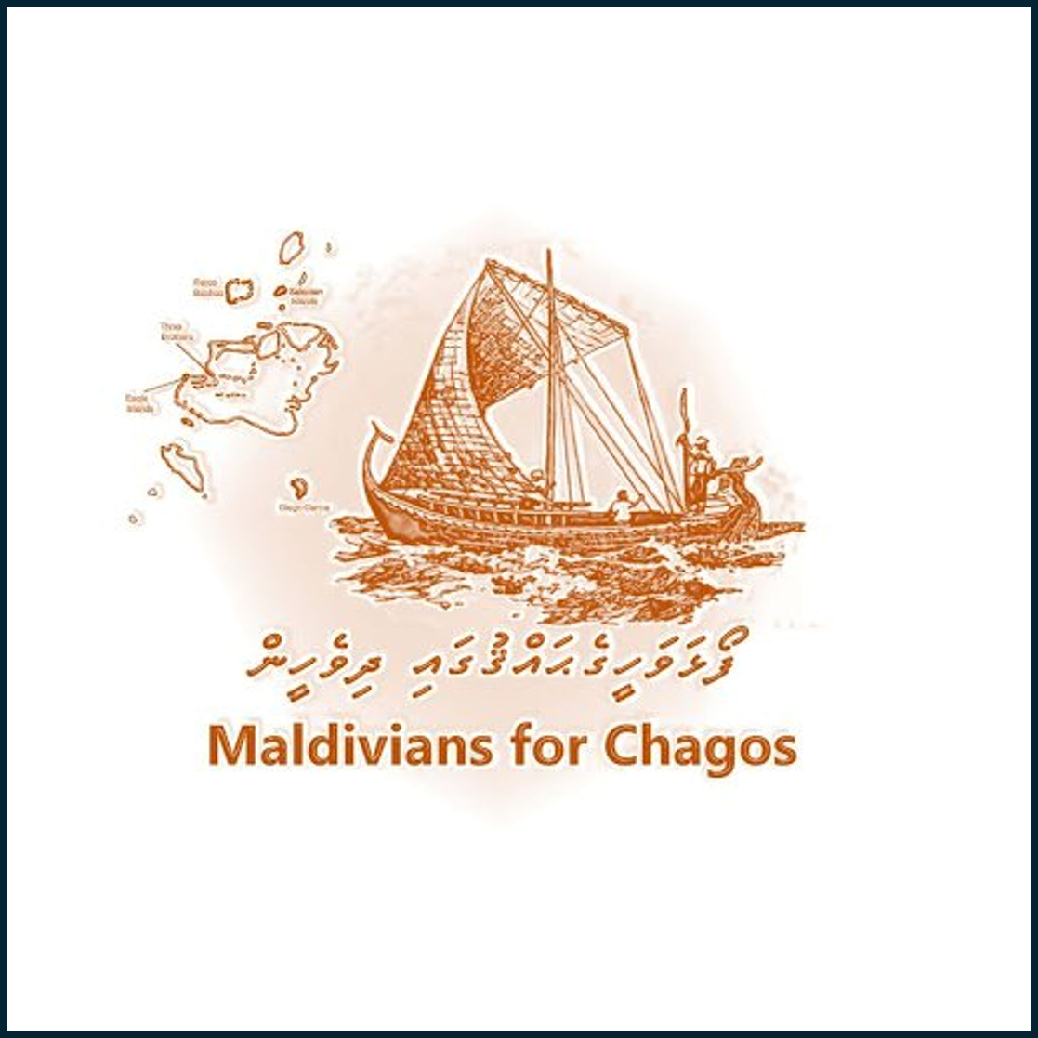
Dom Manuel’s Enduring Sovereign Identity
A Legal-Historical Study of Post-Exile Royal Assertion in the Maldives

Slide 2
introduction
Overview of Sultan Hassan IX (Dom Manuel)
Historical context: Exile, conversion to Christianity
Central theme: Continued assertion of sovereignty post-deposition

Slide 3
Sovereignty Through Correspondence
1545: Alleged suzerainty by the Rajah of Cherical
No concrete historical corroboration
Reflects fluid sovereignty in the region

Slide 4
Royal Titulary as Evidence
Full royal title retained after exile
Claims over:
Three patanas (Cuaydu / Suvadiva)
Seven islands of Pullobay (Foalhavahi/Chagos)
Sumatra coast & Strait of Manacuma
Titulary = Legal and symbolic claim to authority

Slide 5
Portuguese Recognition
1555: Portuguese Viceroy recognized Dom Manuel as King (held only Malé)
1560: Issued royal charter to Manoel da Silveira d’Araujo
1561: Charter confirmed by Viceroy in Go

Slide 6
Geographic Legitimacy
Use of regal seal and geographic detail in titles
Direct link to Chagos Archipelago
Asserted navigation/conquest of Sumatra & Manacuma
Reinforced maritime sovereignty

Slide 7
Implications for Maldivian Sovereignty
Titulary as a form of legal-political assertion
Maintained identity as sovereign post-conversion
Bolstered historical claims over disputed territories (e.g., Chagos)

Slide 8
Conclusion
Dom Manuel never relinquished royal identity
Recognized sovereignty through documents, titles, and foreign validation
Legacy contributes to Maldives’ historical territorial narrative

