Slide 1

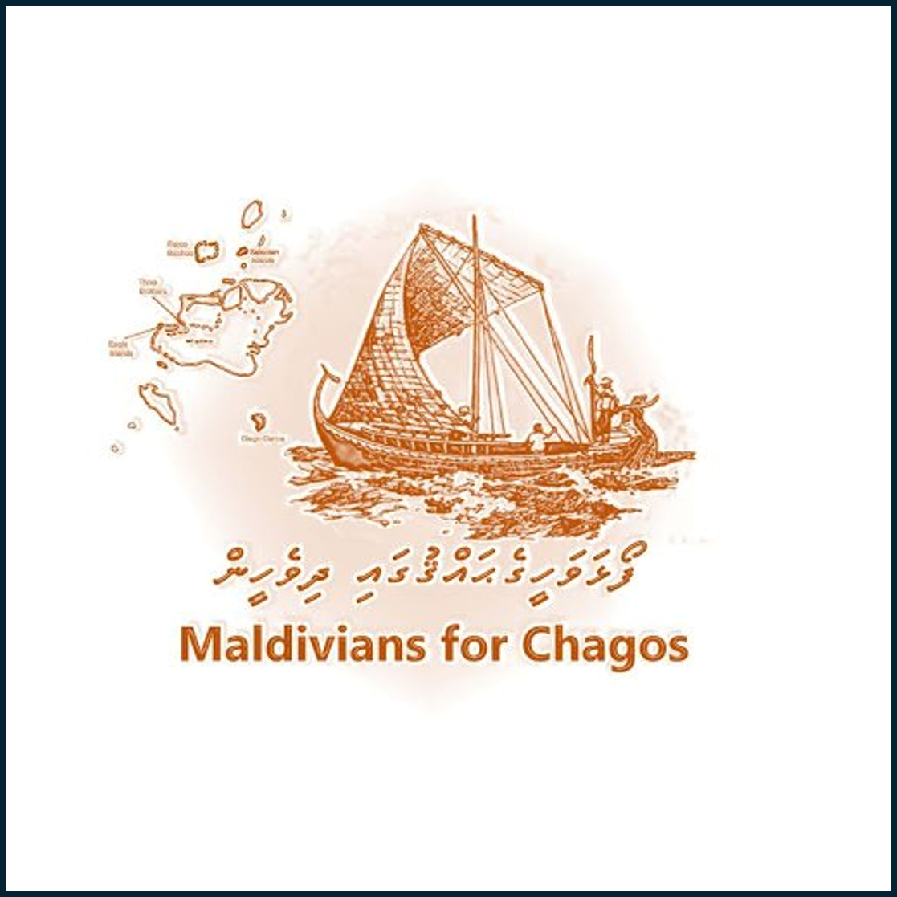
Colonial Illegitimacy and Indigenous Rights
Reassessing Sovereignty Over the Chagos Archipelago

Slide 2
introduction
Overview of the Chagos sovereignty dispute
Central thesis: Colonial arrangements lack legitimacy
Maldives presents a stronger pre-colonial and indigenous claim

Slide 3
Colonial Reallocation & Strategic Interests
1903: Chagos transferred from Seychelles to Mauritius (British colonial reallocation)
1965: Chagos transferred to the UK for £3 million
Neither transfer constituted legal sovereignty

Slide 4
Dissecting Mauritius’ Claim
Based on uti possidetis juris
Mauritius never held original sovereignty
Claim perpetuates colonial injustices

Slide 5
Maldives’ Pre-Colonial Ties
Portuguese records identify Chagos within Maldivian domain
Territories like Folhavahi historically claimed by Maldivian rulers
Maritime and cultural continuity as key factors

Slide 6
Indigenous Identity & Rights
Chagos uninhabited pre-colonial era
Settlers were forcibly relocated by colonial powers
Maldivians are regionally indigenous with ancestral links

Slide 7
Reassessing "Indigenous" Populations
Chagos’ current descendants: not indigenous under international law
Cultural appropriation concerns in Mauritius’ framing
Maldives maintains genuine indigenous proximity

Slide 8
Legal & Moral Argument
Maldives claims rooted in sovereignty, not colonial transfer
Mauritius and Seychelles’ rights stem from colonial benefit
Recognition of regional heritage and indigenous continuity is overdue

Slide 9
Conclusion
Chagos dispute reveals contradictions in post-colonial decolonization
Maldives presents a rightful, historically grounded claim
Calls for correction of colonial-era distortions in territorial ownership

