Slide 1

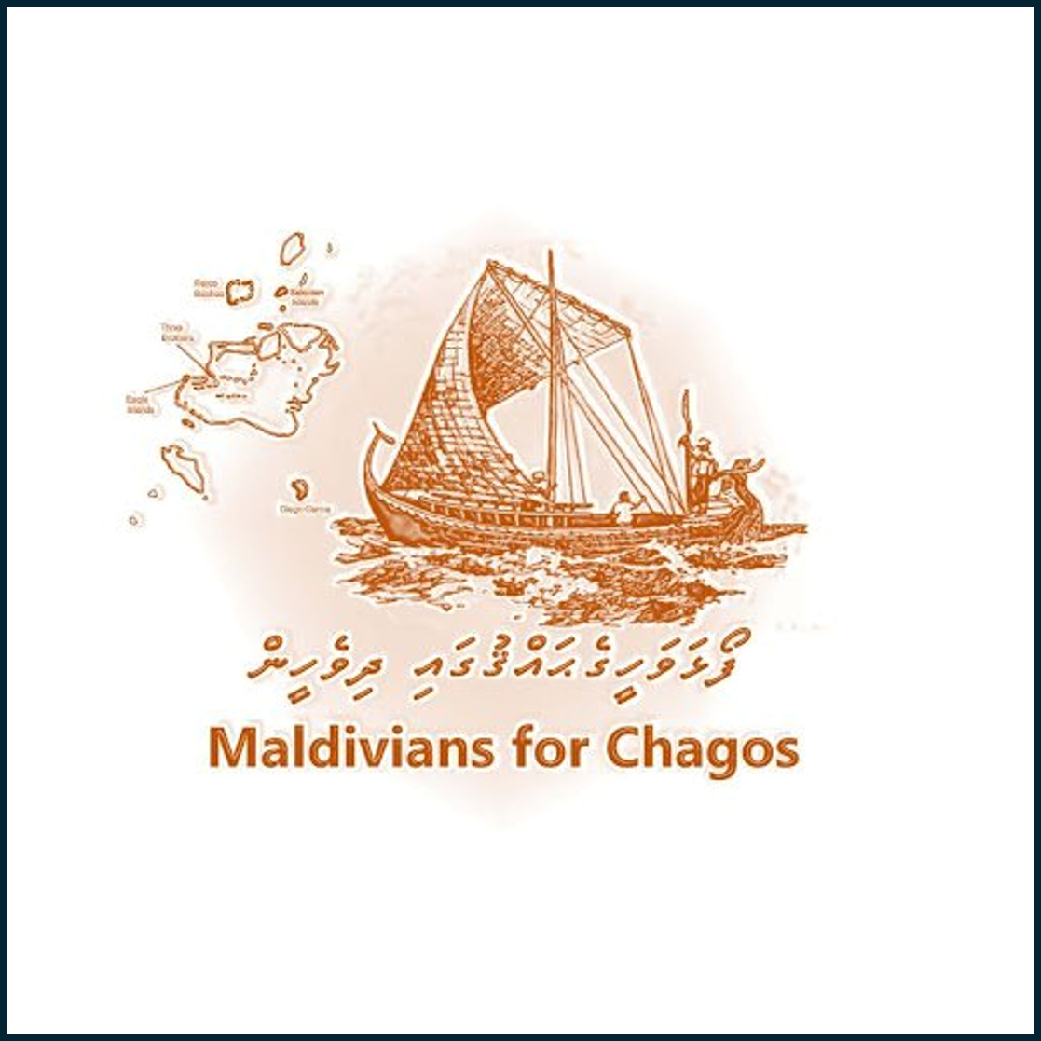
The Chagos Archipelago
The Maldives' Evolving Position, Historical Claim, and Demand for Justice

Slide 2
Summary & Scope
Two-part focus:
Evolving position of the Maldives in legal diplomacy
Historical claim and sovereign rights
Central theme: Redress for colonial injustices and restoration of territorial integrity

Slide 3
Historical Ambivalence to Shift in Support
Initial neutrality due to EEZ concerns
2022: Maldives officially supports Mauritius’ sovereignty claim
Motivating factors:
ICJ (2019) opinion
UN General Assembly Resolution
ITLOS ruling
Diplomatic alignment

Slide 4
Strategic Repositioning
Maldives prioritizes maritime boundary negotiations
Recognition of Mauritius’ claim for EEZ purposes
Does not negate Maldives’ historical narrative

Slide 5
Historical Sovereignty Claim
1560 decree of Sultan Hassan (Dom Manuel)
Mention of “seven islands of Pullobay” (linked to Chagos)
Geographic, cultural, and maritime proximity
Absence of formal sovereignty cession to France or Britain

Slide 6
Colonial Violations
French occupation (1754–1759): unilateral and unlawful
British protectorate post-1796: undermined Maldivian claims
Moresby Survey (1834): conducted without consent
1965 separation: unilateral and undemocratic

Slide 7
Illegitimacy of Mauritius’ Claim
Chagos integrated into Mauritius for colonial administrative ease
Mauritius' independence does not validate prior separation
Historical claim predates British manipulations

Slide 8
ICJ and Gaps in Legal Recognition
ICJ focused solely on Mauritius’ decolonization
Maldivian sovereignty and self-determination not addressed
Call for broader reconsideration of historical context

Slide 9
Demand for Compensation
Occupation without consent = unlawful enrichment
Diego Garcia’s military use benefitted the UK
Maldives seeks formal redress for colonial injustices

Slide 10
Conclusion
Historical sovereignty, not erased by modern diplomacy
Colonial boundary changes lacked legitimacy
Maldives asserts rightful claim and demands recognition and justice

