Slide 1

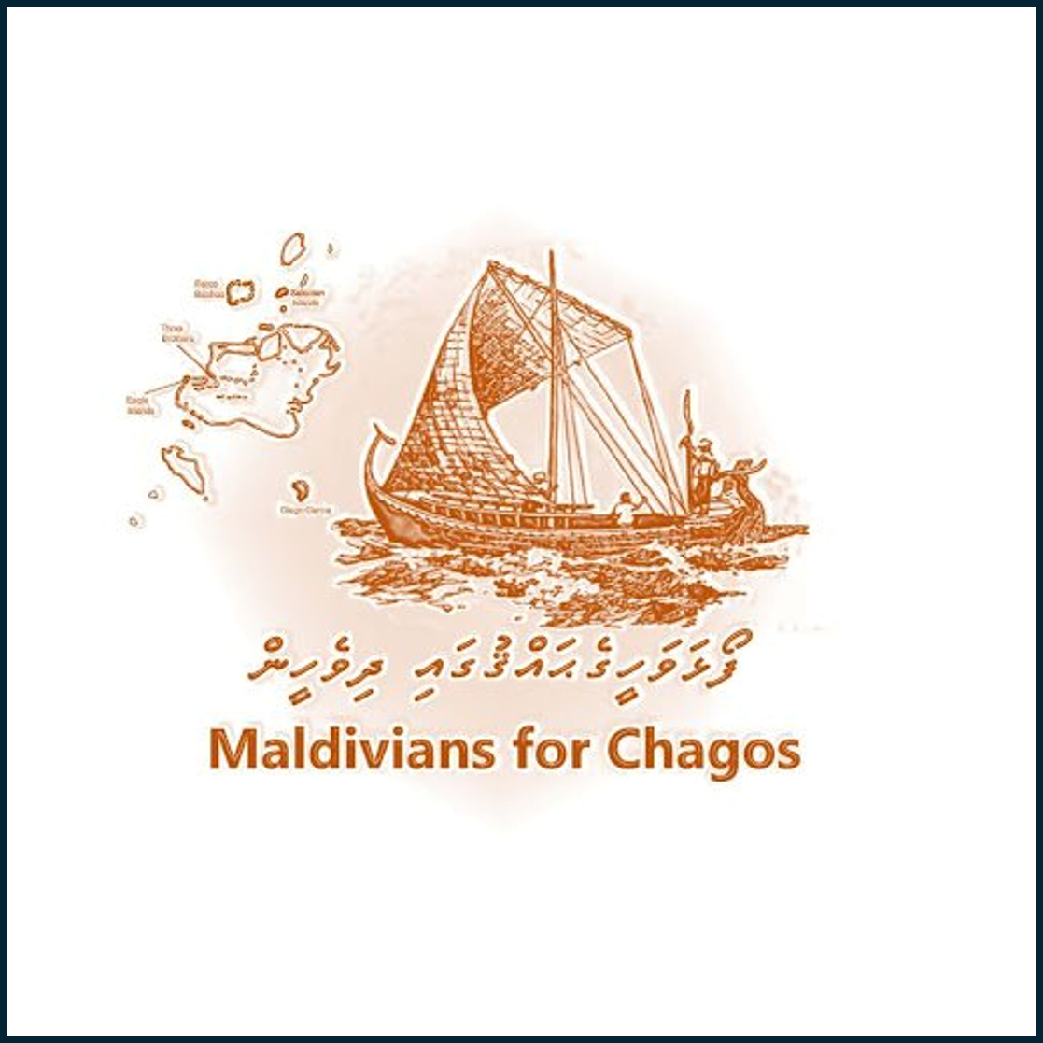
The Maldives’ Legal and Historical Claim to the Chagos Archipelago
A Comprehensive Argument for Sovereignty, Redress, and Re-evaluation

Slide 2
Overview
Structure of the Argument:
  Historical Sovereignty
  Colonial Violations
  Illegitimate Integration into Mauritius
  Call for ICJ Reconsideration
  Demand for Redress
Foundation:
Legal Records,
Colonial History,
Indigenous Rights

Slide 3
Historical Sovereignty
1560 Letter-Patent of Sultan Hassan (Dom Manuel) identifies “seven islands of Pullobay” as part of Maldivian territory
No formal cession to French or British powers
Cultural and geographic proximity supports sovereignty

Slide 4
Colonial Infringements of Sovereignty
French Occupation (1754–1759): Conducted without consent
British Protectorate (1796):
Unilateral suzerainty
1834 Survey by Moresby lacked consultation
1965 Detachment pre-independence violated self-determination
Rising pro-British elite weakened resistance

Slide 5
Illegitimate Integration into Mauritius
Integration driven by British colonial administration
No historical primacy or sovereign connection between Mauritius and Chagos pre-colonialism
Modern claims rest on inherited colonial structure

Slide 6
Scope of the ICJ Opinion
ICJ 2019 Advisory Opinion:
Focused on UK decolonization process
Did not address Maldives’ sovereignty or territorial rights
Maldives’ claim warrants a separate legal review

Slide 7
Legal and Moral Case for Redress
Unlawful Use by France and UK without consent
Strategic Benefits (e.g., Diego Garcia) = Unjust Enrichment
Reparative justice calls for compensation and recognition

Slide 8
Conclusion
Maldives maintains a distinct, pre-colonial claim
Colonial reassignments were illegitimate
International law must reconsider and rectify overlooked sovereignty
Redress is essential for restoring justice

