Slide 1

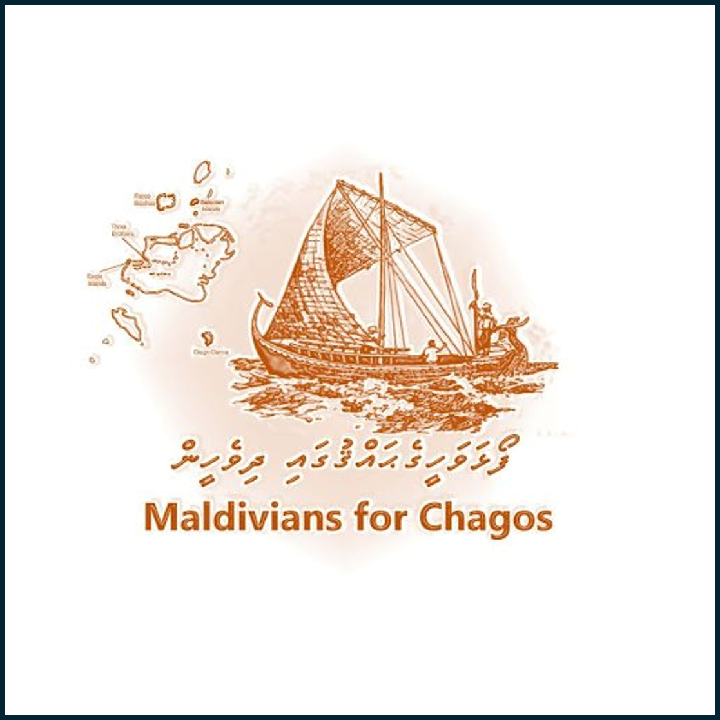
Historical Sovereignty vs. International Consensus
Analyzing the Maldives’ Claim to the Chagos Archipelago in Contrast to Mauritius

Slide 2
Purpose & Scope
Objective: Contrast Maldivian historical sovereignty with Mauritius’ international legal recognition
Focus areas:
Historical claims
Colonial history
Legal evaluations
Strategic implications

Slide 3
Historical Sovereignty – Maldives vs Mauritius
Maldives: Dom Manuel’s 1560 claim over “Pullobay” reflects indigenous pre-colonial sovereignty
Mauritius: Derives claim from colonial British administration
Emphasis on original sovereignty vs. inherited jurisdiction

Slide 4
Violations of Maldivian Self-Determination
British actions occurred despite local resistance and without formal consent
International focus (ICJ opinion) neglected Maldives’ parallel rights
Emphasizes exclusion from key decolonization debates

Slide 5
Legal Context and Strategic Shifts
ICJ (2019) and UNGA support Mauritius
ITLOS (2021) upheld Mauritius in maritime case vs. Maldives
Maldives accepted ruling for EEZ delimitation, but deprioritized sovereignty claims for pragmatic diplomacy

Slide 6
Critique of Mauritius’ Position
Accusations of neo-colonial framing
Mauritius alleged to overlook Maldives’ historical claim
Highlights ongoing colonial dynamics cloaked in legal formalism

Slide 7
Strengths & Weaknesses of Maldives’ Argument
Strengths:
16th-century legal claim
Clear colonial violation of self-determination
Moral appeal for justice
Weaknesses:
Policy inconsistency post-2021
Legal setbacks from ICJ, ITLOS
International diplomatic isolation

Slide 8
Strategic Pathways for Maldives
Build new evidence of external pressure
Develop alternative legal strategies focused on pre-colonial sovereignty
Realign domestic policy and build coalitions for a Maldives-centric narrative

Slide 9
Conclusion
Maldives holds a compelling historic claim
Legal momentum currently favors Mauritius
Reviving the claim requires political will, fresh legal reasoning, and strategic diplomacy

